Slide 1
Equitable College Planner
Designed not to rank colleges by prestige, but to help students find institutions where they can thrive academically, financially, and personally.
Adam Mahmoud
Peter Dickson
UC Berkeley Datathon
16 November 2025

Slide 2
Agenda
01. Background
02 Project Overview
04 Methodology
03. Website Walkthrough
05 Data Critique

Slide 3
Background
College decisions are confusing: students face thousands of institutions and hundreds of variables (earnings, debt, net price, demographics, graduation outcomes).
High school counselors serve over 400+ students each → high-quality personalized guidance is rare.
Low-income students face higher barriers:
High net price after aid
Higher debt burdens
Higher childcare costs for student parents
Limited guidance resources
Existing tools (IPEDS, College Scorecard) are not personalized and often overwhelming.

Slide 4
Project Overview

Slide 5
To Address these Problems, We Built
An interactive College Recommendation Platform powered by the Track 2 datasets.
Provides personalized, data-driven, and equity-focused college recommendations.
Designed to help students understand cost, debt, ROI, equity outcomes, and institutional fit.

Slide 6
How It Works
User enters preferences: state, residency, income, degree level, MSI preference, locality, enrollment size, competitiveness, and faculty ratio.
Backend pipeline filters, merges, and scores institutions based on user-chosen weights.
Logistic similarity function + ROI model generate final rankings.

Slide 7
Website Walkthrough

Slide 8
Methodology

Slide 9
Data Sources
College Results dataset: earnings, graduation rates, admissions, retention, faculty ratio, etc.
Affordability Gap dataset: net price, state minimum wage, childcare-adjusted work hours to close cost gap, MSI flags, institutional type, locality.
Cleaned, normalized, and merged via DuckDB for speed.

Slide 10
Similarity-Based Matching
Filters schools first by accessibility — degree availability, residency rules, and family income bracket
Uses student-defined soft preferences (sector, campus setting, enrollment size, student-faculty ratio, acceptance rate, MSI status)
Numeric preferences scored using normalized distance to student’s target values
Categorical preferences scored using structured similarity matrices (not binary matches)
MSI handling designed to support identity and belonging while preserving choice
Final similarity score generated using a logistic scaling function — ranks relative fit, not "best school"

Slide 11
ROI-Based Financial Model
Computes cost based on residency: in-state, out-of-state, or net price fallback
Estimates completion time using graduation and retention rates (bounded to avoid extreme distortions)
Calculates expected earnings using federal median wage data + adjustment for institutional selectivity
Applies work-burden penalty to reflect hidden affordability barriers for lower-income students
Final ROI standardized so values are comparable across institutions
Designed to promote financial sustainability and transparency, not prestige-based outcomes

Slide 12
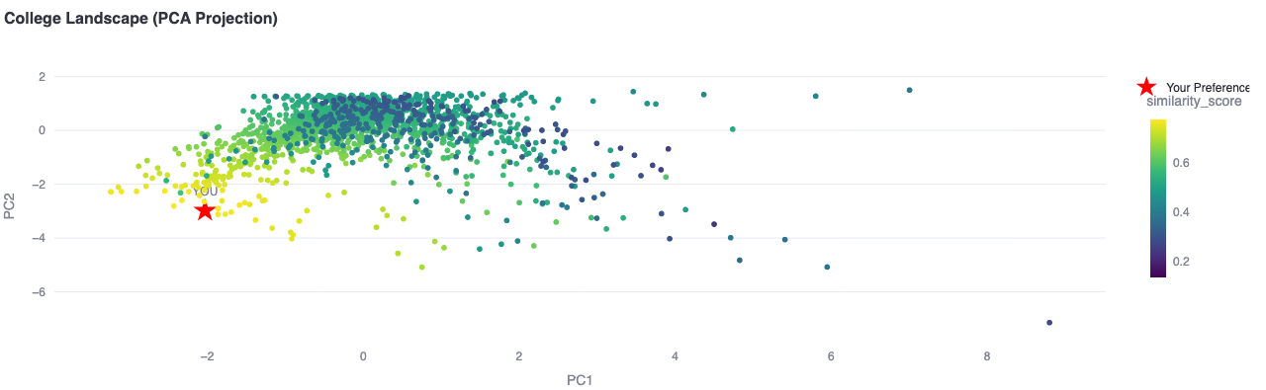
Principal Component Analysis Graph
Converts key quantitative attributes (enrollment size, admit rate, student-faculty ratio) into a 2D representation
Standardizes values first so no metric dominates due to scale differences
Student preferences are projected into the same space — visualizing personal alignment with the landscape

Slide 13
Data Critique

Slide 14
Limited Columns
As a team we limited ourselves to only choosing a small number of columns that we believed were important to calculate similarity scores and ROI
Drawbacks of this include potentially untested and missed information that could have bettered enabled us to give users more accurate and equitable results.
Due to time constraints we were unable to look at whether students who have dependents could have potentially different ROIs at certain colleges than regular students
Next Steps: Spend more time looking at more features and deciding what to include in our cleaned dataset.

Slide 15
High Amounts of Null Values in Features
These datasets contained columns with high percentages of the values being null.
Factored in the amount of non-null data in decision to keep columns
This potentially also affected ROI scores as colleges lacked the proper data for the ROI to be calculated.
Solution: keep as many colleges for people to choose from and leave -99.9 placeholder for Null ROI values, then order by similarity instead

Slide 16
Thank you

